Slide 1







Holding elections during Covid-19?
Presentation to Electoral Commission of South Africa, 1 July 2021
Salim S. Abdool Karim, FRS
Director: CAPRISA
CAPRISA Professor of Global Health, Columbia University
Adjunct Professor in Immunology and Infectious Diseases, Harvard University
Adjunct Professor of Medicine: Cornell University
Director: DSI-NRF CoE in HIV Prevention
Pro Vice-Chancellor (Research): University of KwaZulu-Natal
Associate: Ragon Institute of MGH, MIT and Harvard University
CAPRISA hosts a
DST-NRF Centre of Excellence in
HIV Prevention
CAPRISA hosts a MRC HIV-TB Pathogenesis and Treatment Research Unit
CAPRISA is the UNAIDS Collaborating
Centre for HIV Research and Policy

Slide 2
Overview
Current state of the Covid-19 in South Africa
Estimation of possible end dates of 3rd wave
Vaccination in South Africa by October 2021
Likelihood of community immunity by October 2021
SARS-CoV-2 exposure risk associated with elections
Additional measures recommended to mitigate this risk
Would the situation be more conducive for elections 3 months or 6 months later?

Slide 3
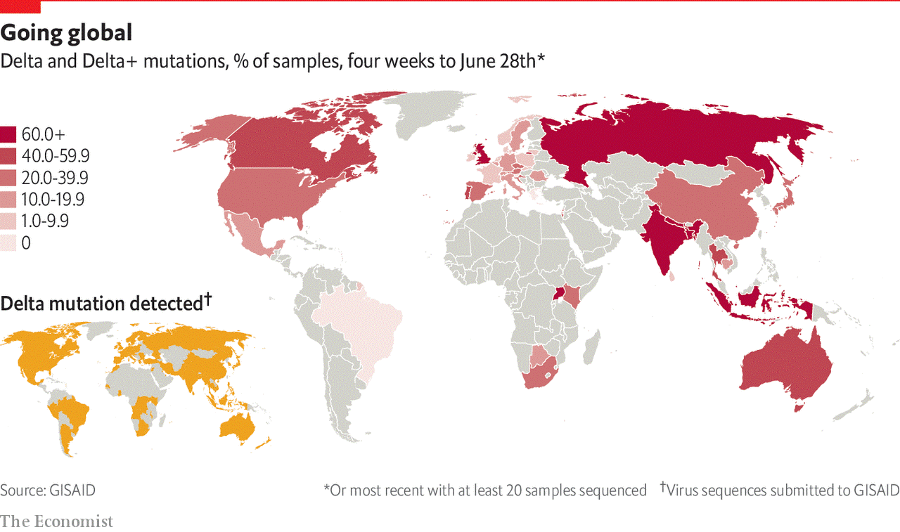
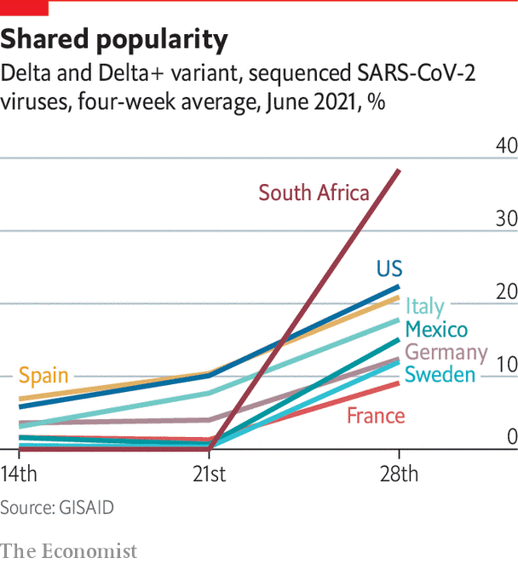

Delta variant is fast becoming the world’s dominant strain of SARS-CoV-2

Slide 4



Impact of variants on the SARS-CoV-2 pandemic:
Covid-19 surges due to variants of concern in India, Brazil and SA
7-day moving average of daily cases per million
Source: Our World in Data

Slide 5
Impact of variants on the SARS-CoV-2 pandemic:
Covid-19 surges due to variants of concern in India, Brazil and SA
Gamma
variant
Beta
variant
Delta
variant
Delta
variant
7-day moving average of daily cases per million
Source: Our World in Data

Slide 6
Covid-19 in South Africa
7-day moving average of new cases, hospital admissions and in-hospital Covid-19 deaths –
1 July 2021
Before lockdown
Level 5
Level 4
Level 3
Level 2
Level 1
Level 1 (start of 2nd wave)
L3 adjusted
Level 2
Level 3 readjusted
Level 3
Level 1
16,130
Level
4
(301,284)
(1,973,972)
(60,647)
New cases
7-day moving average of daily cases
Hospital
Admissions
Deaths
Source of hospital admissions data: Lucille Blumberg, Richard Welch and Waasila Jassat – DATCOV, NICD

Slide 7
SARS-CoV-2 cases in 1st, 2nd & 3rd waves in SA
(7-day moving average cases per 100,000 population – up to 30 June)
19,042 cases ( 32 cases / 100,000 pop)
16,130 cases (27 cases /100,000 pop)
Second wave
First wave
Third wave
Data source: Department of Health; Analysis: Cheryl Baxter

Slide 8
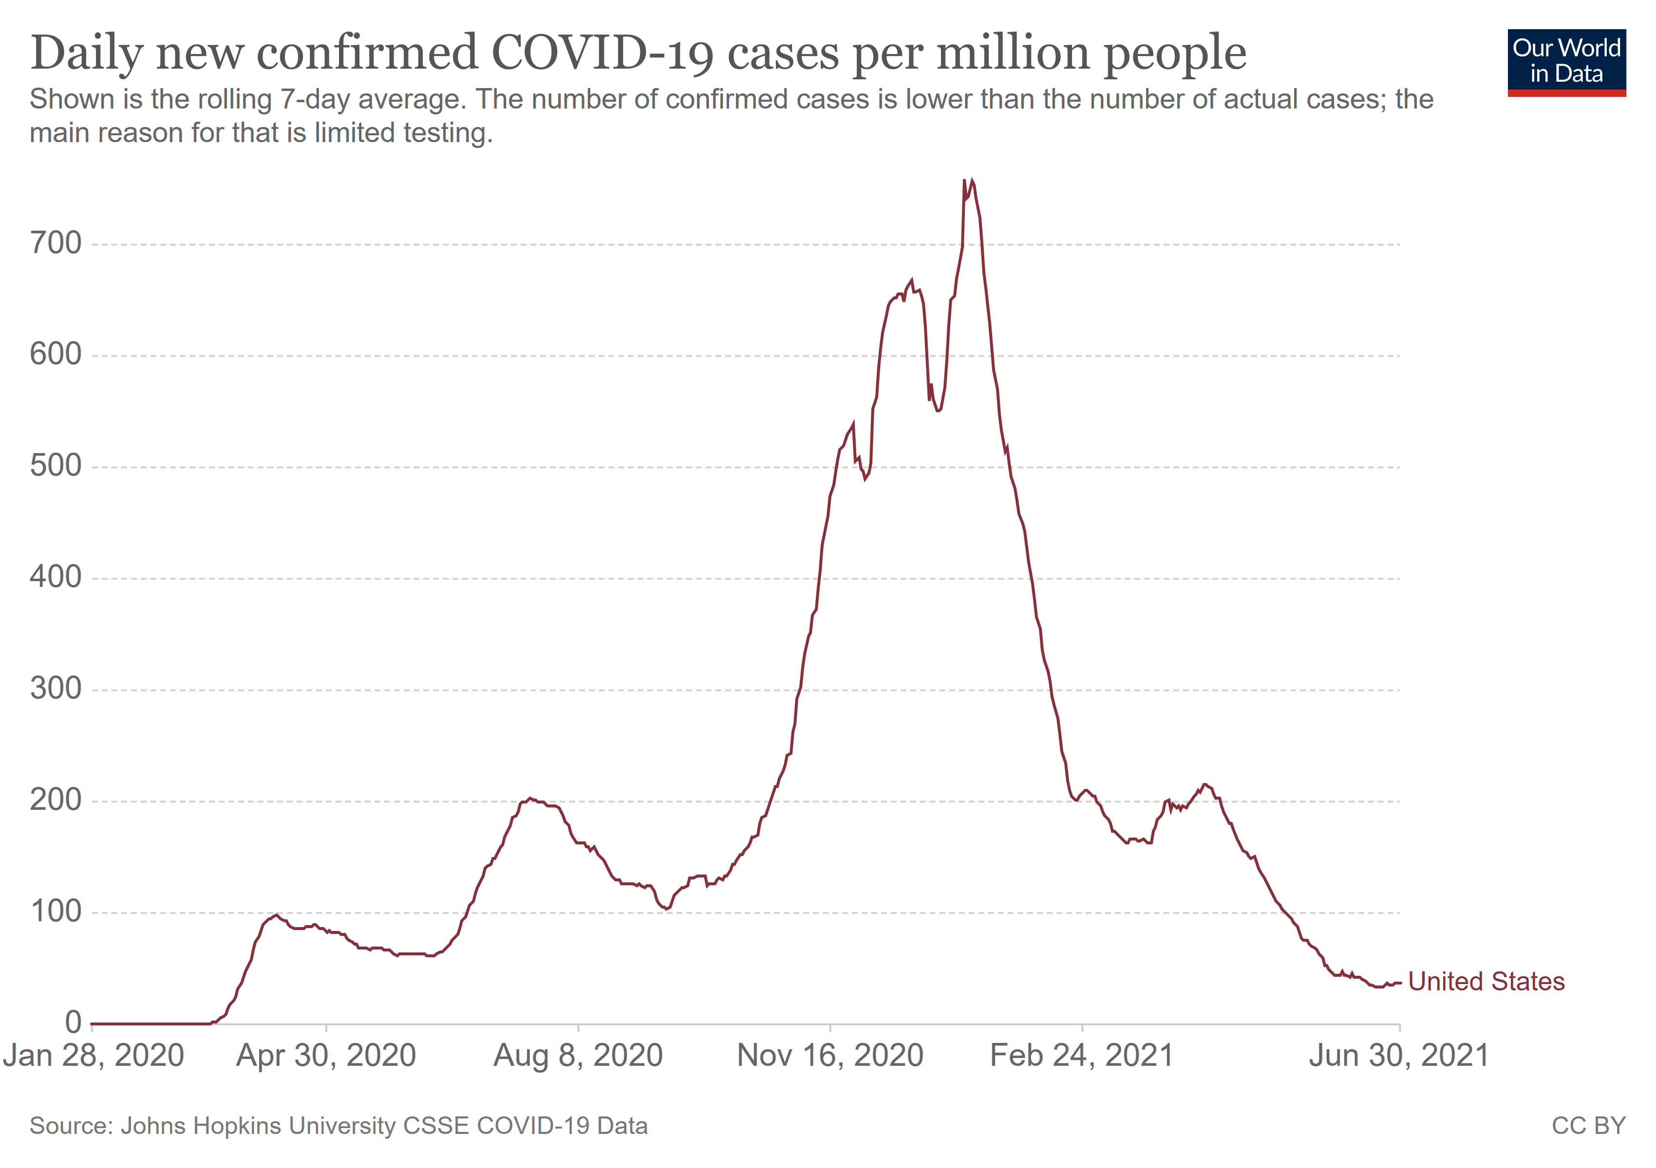
US elections in 2020 held when epidemic was at 29 cases per 100,000 population
US elections
3 November 2020
29 cases per 100,000

Slide 9
SARS-Cov-2 cases in 1st, 2nd & 3rd waves in Gauteng
(7-day moving average cases per 100,000 population – up to 30 June)
~67 cases / 100,000 population
Third wave
~35 cases / 100,000 population
Second wave
First wave
Data source: Department of Health; Analysis: Cheryl Baxter

Slide 10
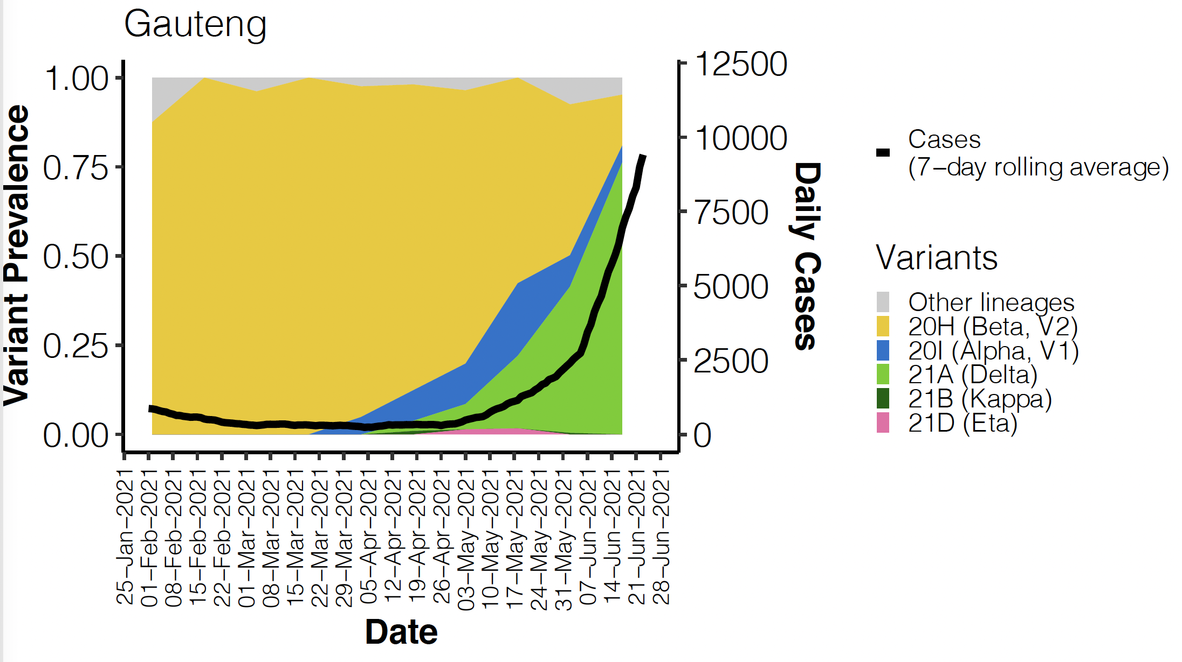


Circulating variants in Gauteng
Month | Covid-19 cases | Viral sequences | Alpha | Beta | Delta
May | 32,438 | 244 | 13% | 64% | 15%
June | 164,192 | 341 | - | 37% | 53%
Notes:
The report does not include data for weeks 14-17 and does not provide the % for Alpha in June

Slide 11
SARS-Cov-2 cases 1st, 2nd & 3rd waves in Western Cape
(7-day moving average cases per 100,000 population – up to 30 June)
Second wave
First wave
Third wave
Data source: Department of Health; Analysis: Cheryl Baxter

Slide 12
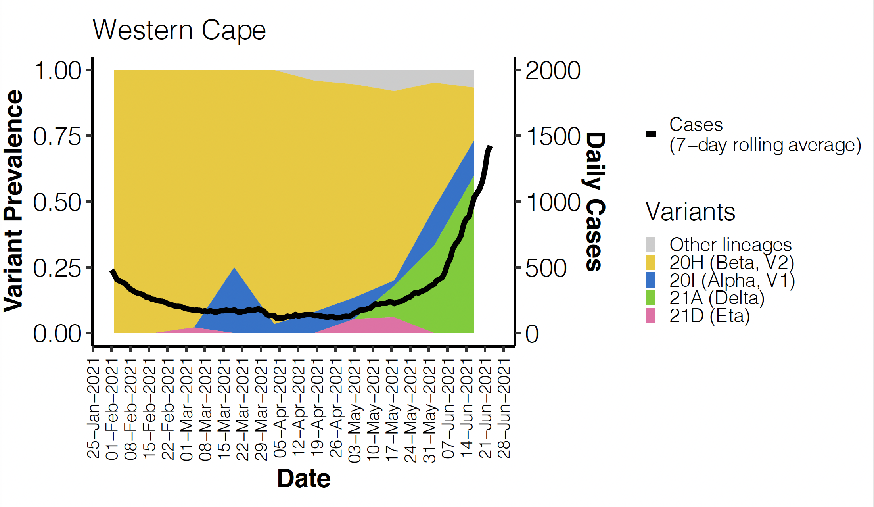
Circulating variants in Western Cape

Slide 13
SARS-Cov-2 cases in 1st, 2nd & 3rd waves in Eastern Cape
(7-day moving average cases per 100,000 population – up to 30 June)
Data source: Department of Health; Analysis: Cheryl Baxter

Slide 14
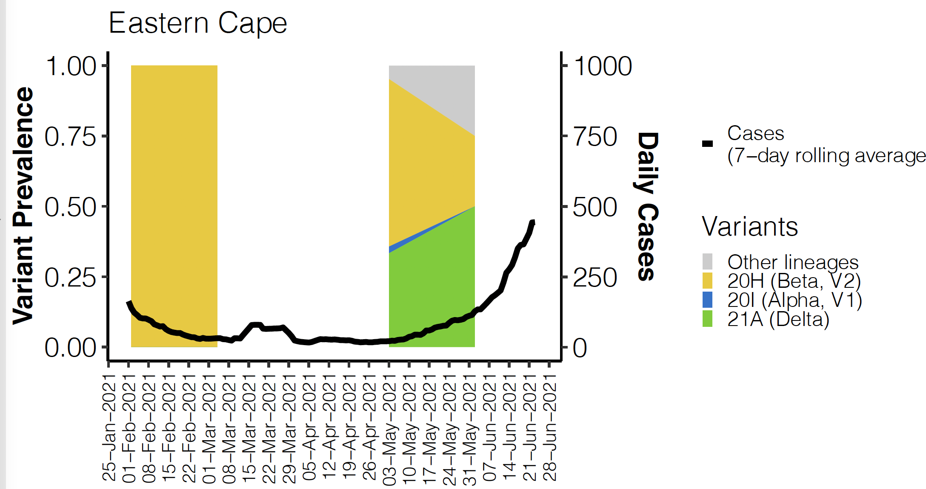
Circulating variants in Eastern Cape

Slide 15
SARS-Cov-2 cases in 1st, 2nd & 3rd waves in KwaZulu-Natal
(7-day moving average cases per 100,000 population – up to 29 June)
Second wave
First wave
Third wave
Data source: Department of Health; Analysis: Cheryl Baxter

Slide 16
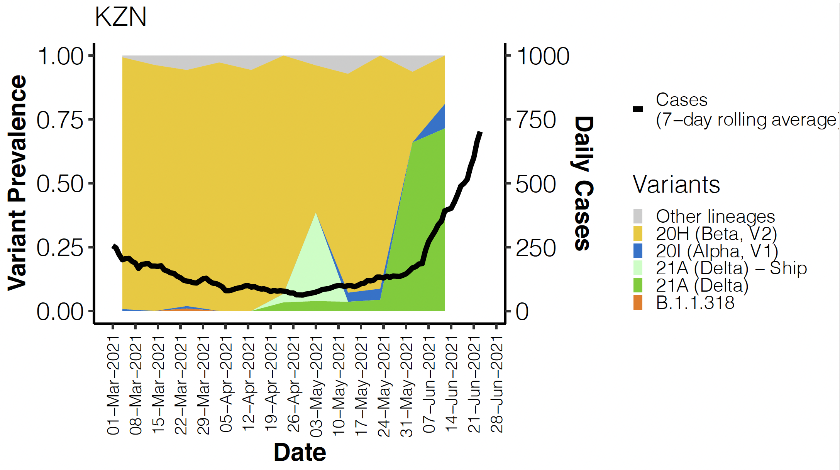
Circulating variants in KwaZulu-Natal

Slide 17
Cases numbers in October? Estimations of end of 3rd wave, based on duration of 1st and 2nd waves in SA
150 days (11 Oct)
113 days (5 Sept)
1st wave
74 days
Inter-wave
94 days
2nd wave
75 days
75 days (29 Jul)
99 days
New cases
7-day moving average of daily cases
Hospital
Admissions
Deaths
Note: New variant and other factors may change epidemic trajectory. Analysis: Cheryl Baxter
Notes:
extrapolate

Slide 18
Overview
Current state of the Covid-19 in South Africa
Estimation of possible end dates of 3rd wave
Vaccination in South Africa by October 2021
Likelihood of community immunity by October 2021
SARS-CoV-2 exposure risk associated with elections
Additional measures recommended to mitigate this risk
Would the situation be more conducive for elections 3 months or 6 months later?

Slide 19
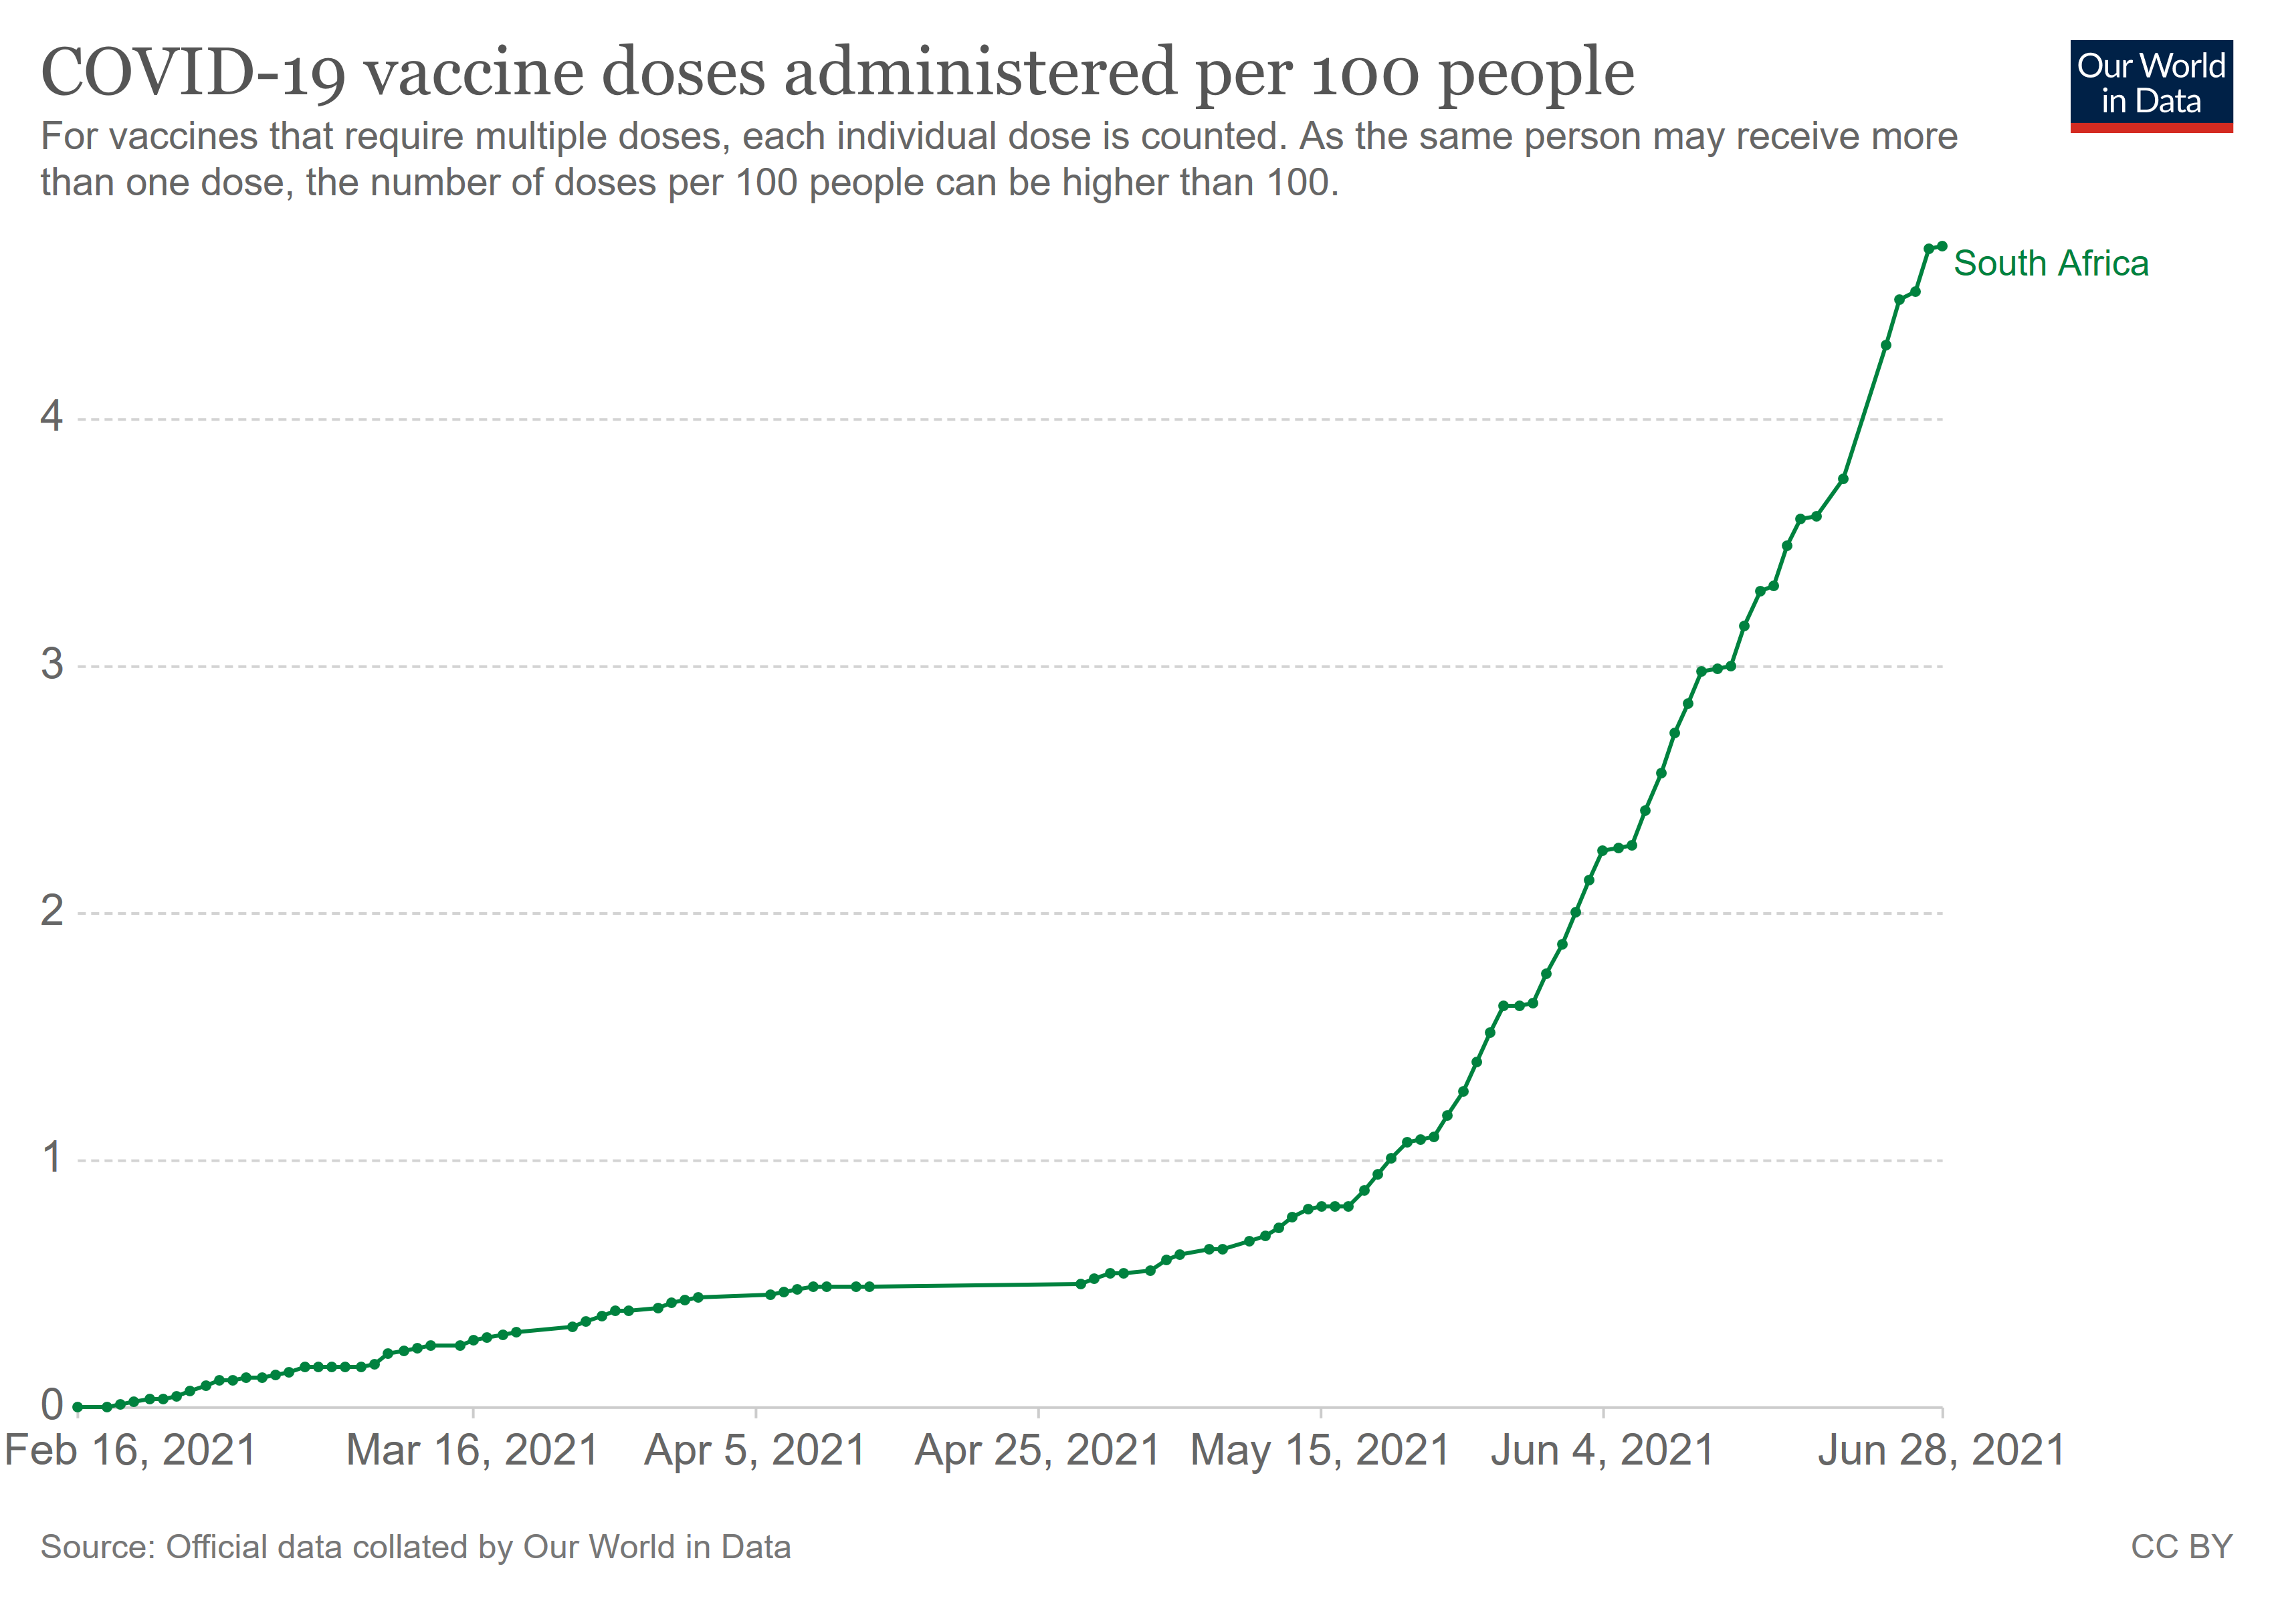
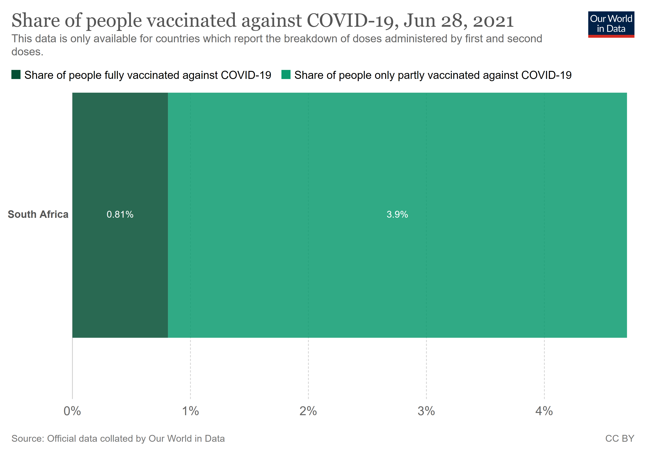
Vaccinations in South Africa
3,026,636 doses administered
5.1% of population at least 1 dose
125,970 doses administered on 30 June 2021
0.8%
4.3%
Estimations:
If 125k – 200k vaccinated per day by end July
200k – 250k vaccinated per day by end Aug
250k – 300k vaccinated per day by end Sept
~ 16.3 million vaccine doses (~20% coverage) administered by 1 Oct

Slide 20
Likelihood of community immunity by October 2021
Actual level of immune protection required for herd immunity not known
Population coverage = [R₀ – 1 / R₀] / ε
If R₀ =2.5, & vaccine efficacy (ε) = 80% then 75% vaccine coverage is required (note R₀ in Wuhan was 2-3) (note ε of 80% used to cover both ε of Pfizer = 95% and J&J = 64%)
Estimates from mathematical models range from 43% to 82% - SA aiming for 67%
HSRC estimates anti-vaxx = 18%, unclear on vaccines =15% and 67% want vaccines
SA needs to vaccinate ~75% people with vaccine ~80% efficacious to get herd immunity
Note: vaccines can only be administered to adults at this stage
SA will not have sufficient vaccine coverage for herd immunity by October - may not even achieve this in 2021
Source: Anderson RM Lancet 2020; HSRC report: http://www.hsrc.ac.za/

Slide 21
Overview
Current state of the Covid-19 in South Africa
Epidemiology of Covid-19 in South Africa in October 2021
Vaccination in South Africa by October 2021
Likelihood of community immunity by October 2021
SARS-CoV-2 exposure risk associated with elections
Additional measures recommended to mitigate this risk
Would the situation be more conducive for elections 3 months or 6 months later?

Slide 22
SARS-CoV-2 exposure risk associated with elections
Election activities impacting exposure risk:
  Occupational exposure for IEC staff and campaign staff
  House-to-house visits for individual interactions when electioneering
  Small group meetings and discussions when electioneering
  Large group rallies and marches
  Election day queues and polling booth risks
The risks associated with these activities are principally
  Gatherings, especially indoors
  Movement of people
  Level of adherence to public health protection measures (masks etc)

Slide 23
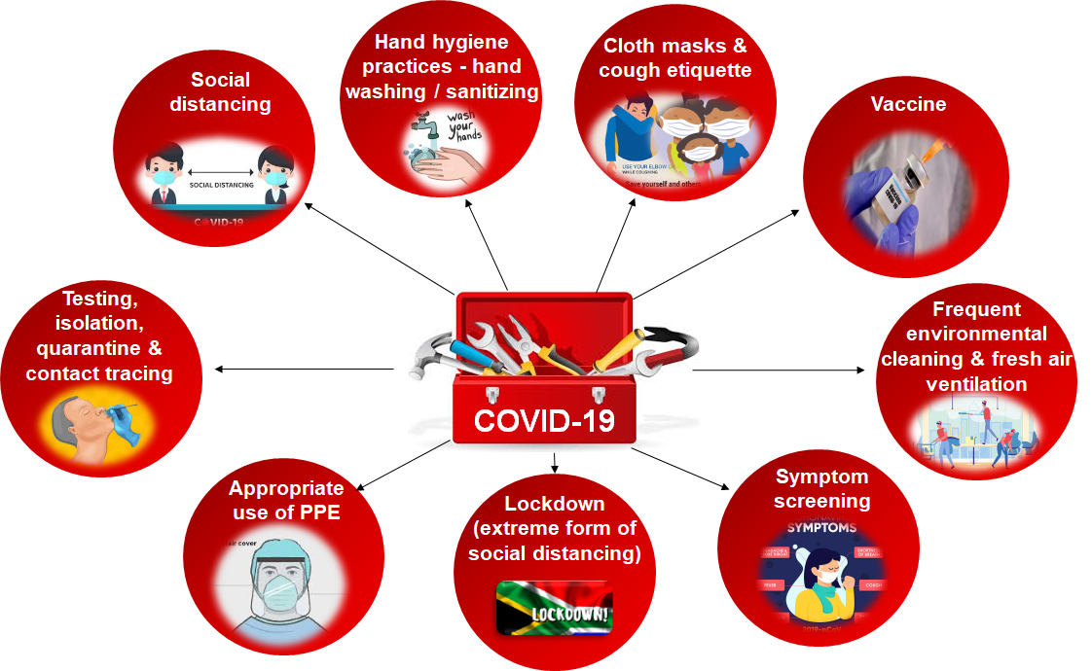
Most election-related risks can be mitigated with combination prevention from the toolbox
Note: Beware the risk of corruption when procuring supplies to mitigate the risk of Covid-19

Slide 24
Overview
Current state of the Covid-19 in South Africa
Epidemiology of Covid-19 in South Africa in October 2021
Vaccination in South Africa by October 2021
Likelihood of community immunity by October 2021
SARS-CoV-2 exposure risk associated with elections
Additional measures recommended to mitigate this risk
Would the situation be more conducive for elections 3 months or 6 months later?

Slide 25
Estimated case numbers if elections delayed by
3 or 6 months (assuming 3rd wave is 1.5 x as long as 1st and 2nd waves)
Oct
election
3-month delay
6-month delay
7-day moving average of daily cases
Note: New variant and other factors may change epidemic trajectory. Analysis: Cheryl Baxter
Notes:
extrapolate

